Slide 1
TEAM 28
Data Visualization Associate Early Internship

Slide 2
Project objective
Objective:
To streamline the student application tracking process and identify key patterns that drive campaign success.
Problem it Solves: Lack of visibility into application performance, gender distribution, and campaign efficiency, limiting data-driven decision-making.

Slide 3

Data Collection and processing
Data Collection:
Excelerate
Processing:
Cleaned and structured datasets
Merged into a unified dashboard for analysis
Tools Used: [Excel, SQL, looker Studio, Tableau.

Slide 4
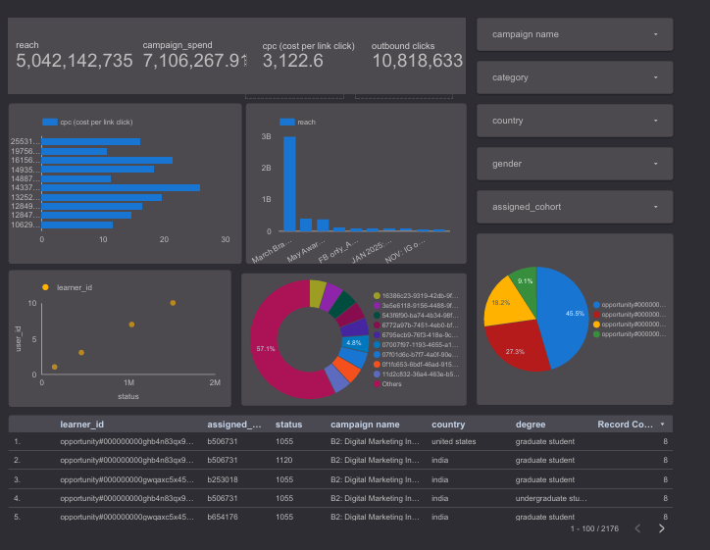
Dashboard Design Overview
This dashboard provides a comprehensive overview of a digital marketing campaign's performance.

Slide 5
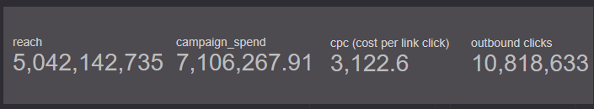
Reach:
This Displays the total number of users reached which 5,042,142,735.
Campaign Spend:
This shows the total marketing expenditure which is 7,106,267.91.
CPC (Cost Per Link Click):
This shows the average CPC value which is 3,122.6.
Outbound Clicks:
The total number of outbound clicks from the campaign: 10,818,633

Slide 6
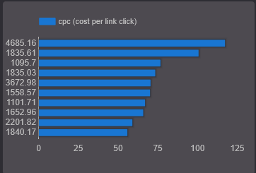
CPC (COST PER LINK CLICK)
Highlights variation in cost per link click across learners.
Identifies costly vs. efficient user interactions

Slide 7
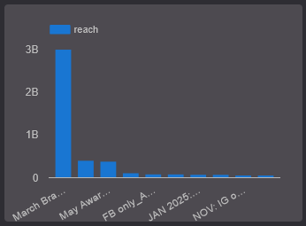
MONTHLY REACH OVER-TIME
This shows the Monthly breakdown of user reach, and it shows March and April are the highest audience reach and Campaign performance declines in later months.

Slide 8
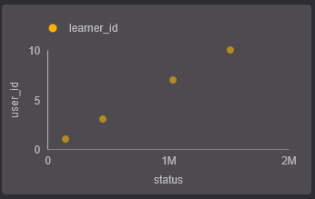
STATUS VS LEARNER ID
Visualizes how engagement levels vary by learner status.
Useful for segment analysis.

Slide 9
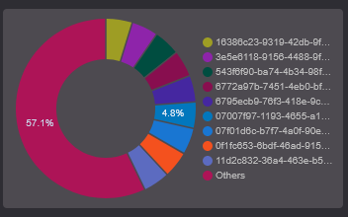
STATUS DISTRIBUTION
This is a Visual indicator of campaign conversion funnel distribution.
This Shows proportion of different learner statuses.
The largest portion (57.1%) indicates a dominant status category among learners.

Slide 10
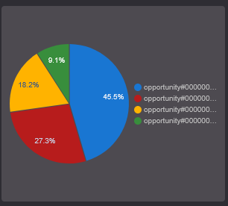
Learner Contribution Share (Bottom Right Pie Chart)
This Displays the percentage share of engagement or actions by top learner IDs.
Top 3 learners contribute 91.3% of interactions.
Indicates heavy skew in user activity.

Slide 11
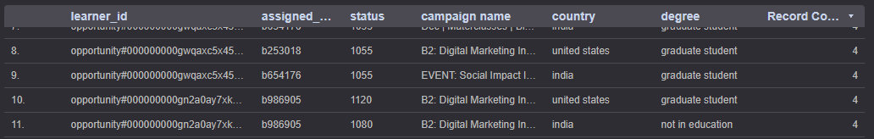
Data Table
Learner-specific campaign records:
IDs, assigned cohort, status, country, degree.
Helps with tracking individual-level performance.

Slide 12
INSIGHTS
Reached over 5B people with 10.8M clicks.
High CPC (AED 3,122) in some campaigns — needs optimization.
Majority of users from India & Bangladesh, mostly graduate students.
A few campaigns and opportunities dominate performance.

Slide 13
Impact
High spend with uneven returns.
Skewed engagement across campaigns and learner groups.
Data issues found (e.g., incorrect dates, duplicate learners).

Slide 14

RECOMMENDATIONS
Optimize high-CPC campaigns.
Target audience by country, degree, and gender.
Promote less-engaged opportunities.
Clean and validate data for accurate tracking.

Slide 15
THANK YOU

